Slide 1

Lecture #3

Slide 2
Point
Pixel: The smallest dot illuminated that can be seen on screen.
Picture: Composition of pixels makes picture that forms on whole screen
Resolution: The display resolution is defined by the number of rows from top to bottom, and number of pixels from left to right on each scan line.
In general, higher the resolution, more pleasing is the picture.
Higher resolution means a sharper, clearer picture

Slide 3
Example
Poster A (Low Resolution)
This poster was made with big, chunky stamps. Each stamp is a single color.
The Pixel is one single stamp mark on the paper. It's just a big, solid blob of ink.
The Picture is the whole poster made from hundreds of these big stamp marks.
The Resolution is low because you didn't need many stamps to fill up the poster. You can count the stamp marks easily.
What's wrong with it?
The face looks blocky and blurry. The curve of the smile looks like a staircase. You can't see any details like skin pores or individual eyelashes.
It's just a rough approximation of a face.

Slide 4
Poster B (High Resolution)
This poster was made with a super fine-tip pen. The tip is so tiny it can barely be seen.
The Pixel is one tiny, tiny dot of ink from that pen. It's the smallest possible mark.
The Picture is the entire poster, made from millions of these microscopic dots.
The Resolution is high because it took a huge number of these incredibly tiny dots to fill the same-sized poster.
You could never count them all.
Why is it better? The face looks incredibly sharp and clear. The curves are smooth. The details are so fine you can see
every strand of hair and every little detail.
It looks real because the dots are too small for your eyes to see individually. They all blend together perfectly.

Slide 5
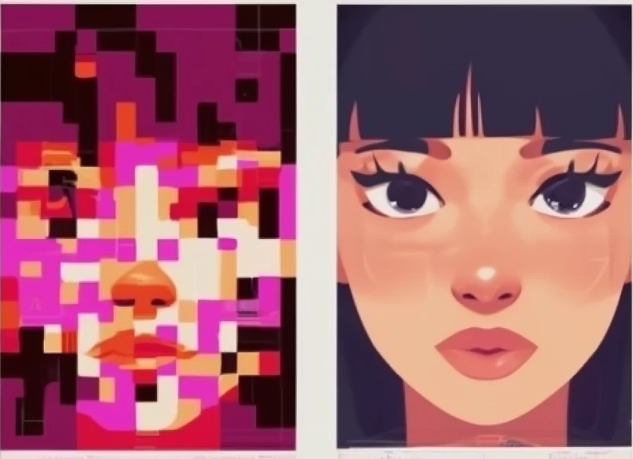
Side-by-side comparison demonstrating screen resolution. On the left, labeled 'Poster A: Low Resolution', a pixelated, blurry, and blocky portrait of a woman's face, made of large, visible squares like big stamps. On the right, labeled 'Poster B: High Resolution', a sharp, ultra-detailed, and clear portrait of the same woman

Slide 6

How is Text Displayed on a Screen?
Each character (A, B, C, …) is stored as a binary code (e.g., ASCII, Unicode).
The display system has a character generator or font table that defines the shape of each character in terms of pixels (a bitmap or vector).
When you type a character:
The system looks up its pixel pattern.
The pixels are turned ON or OFF (or set to a color) at the correct points on the screen.
The result: The collection of lit pixels forms visible text.

Slide 7
Text and Graphics Modes
Video cards are responsible to send picture data to monitor each time it refresh itself.
Video cards support both different text and graphics modes.
Modes consist of their own refresh rate, number of colors and resolutions (number of rows multiply by number of columns)

Slide 8
How text displays
Text modes need two bytes in VDU memory to represent each character on screen
ASCII value in one byte
Attributes in second byte
One byte says what to show, the next byte says how to show it. Together, they define everything about a single character on the screen.

Slide 9
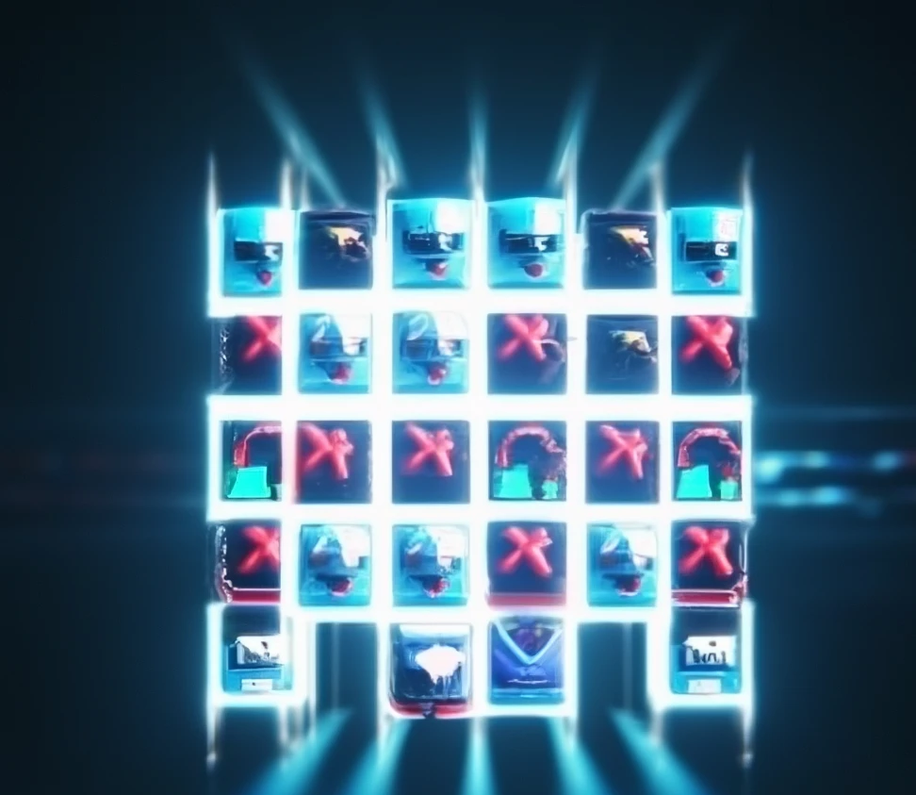
Example
Imagine your screen is a grid of little squares. Each square can show one character (like a letter, number, or symbol).
For each square, the computer needs to remember two things:
What character to show? (e.g., Is it the letter 'A' or a smiley face?)
How should it look? (e.g., Is it red? On a blue background? Is it blinking?)

Slide 10
Graphics Mode Colors
In the graphics mode each pixel on the screen has a color associated with it
Difference between text mode and graphics mode
Each pixel is simply one color or another.
The number of colors that each adapter can support and the way each adapter generates these colors is drastically different.

Slide 11
Colors in VGA
VGA has 4 color planes – red, green, blue and intensity, with one bit from each of these planes contributing towards 1 pixel value.
There are lots of ways that you can write pixel on screen. You can write pixel on screen by using one of the following methods:
BIOS Call: Ask the computer's built-in software to do it. Easy but slow.
Direct Access: Command the graphics hardware yourself. Hard but fast.
Library Function: Use a helper toolkit to do it for you. The modern, balanced way.

Slide 12
Method 1
Using Video BIOS Services (The "Help Desk")
How it works: You don't talk to the manager (VGA) directly. Instead, you call a "help desk" (the BIOS) and tell them what you want.
You say: "Hey, help desk, please turn on the light at position (X=100, Y=50) to Bright White."
Pros: This is the easiest method. The help desk handles all the complicated stuff for you.
Cons: It's the slowest method. Calling the help desk for every single pixel takes a long time.

Slide 13
Method 2
Accessing Memory and Registers Directly (The "Manual Control Room")
How it works: You walk past the help desk, go straight into the manager's control room, and flip the switches yourself.
What you do: You directly write to the special video memory to say which bulb to change. Then you directly fiddle with the VGA's registers (the control knobs) to set the color.
Pros: This is the fastest and most powerful method. You have total control.
Cons: This is the most difficult and dangerous method. You must know the exact addresses of the memory and registers. If you make a mistake, you could crash the whole system.

Slide 14
Method 3
Using Library Functions (The "Assistant")
How it works: You have a smart assistant (a graphics library like SDL or OpenGL) who knows the control room inside and out. You just tell the assistant what you want.
You say: "Assistant, draw a red pixel at (100, 50)."
The assistant then handles the complex task of either calling the help desk (BIOS) or going into the control room (direct access) for you.
Pros: It's easy for you and still very fast. It's the best of both worlds.
Cons: You need to have the assistant (the library) available.

